Slide 1

MAVS ICE CREAM EMPORIUM
Project made by:
Vivek Patel
Mentor: Professor George Rice
CSE_1325_PROJECT_MICE

Slide 2
PROJECT MOTO
This project is made for an ice cream shop, to store data and help owners to manage their shop data.
The application is sensitive and take care of privacy and data security. Owner has its own password and id. So that another person can not make changes in the application.
Application features many essential functions for an ice cream shop, like saving data and taking care of data saved by the owner, manager or server.
Application provides most important financial data report, which accounts for the profit or loss in the shop.

Slide 3
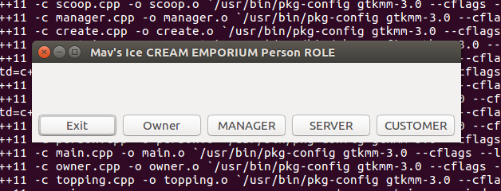
FEATURES
When user will start the application then he will get an option to choose his role.
After choosing role user will asked to verify his/ her identity by asking for user id and password to login in the application.
If user is new customer, then he can continue by adding him in the data or continuing as a guest. Old customer can enter their name and phone number to continue as a customer also.
If user identity is not verified then it will give you an error message.
And if user identity is verified, then a main MAVS EMPORIUM WINDOWS will appear.

Slide 4
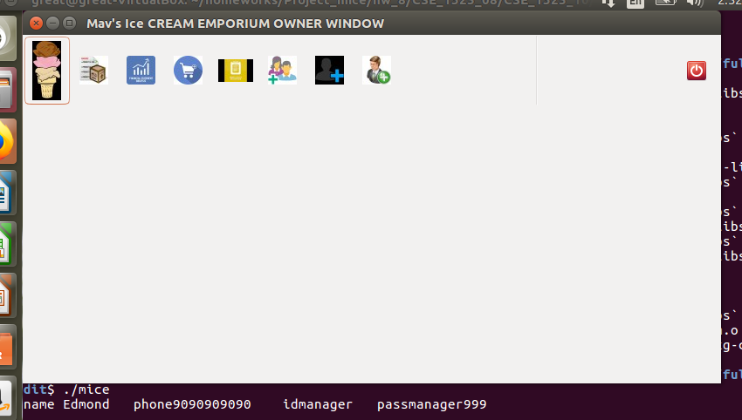
OWNER WINDOW
Owner windows have every function from creating an order to creating an manager. Owner has access to everything in the application.
While manager cannot create another manager, while he have access to everything.

Slide 5
Server
Server can create customer, an order, restock items on the basis of needs.
Server can save data, fill order and can get paid for order.
Server salary is dependent on the number of orders is filled.
It can be changed on the basis of owners requirement.
Server has access to all the sides besides of some critical reports like financial reports, it cannot create himself or manager.

Slide 6
Customer
Customer can create an order.
They can see the inventory report to find whether item of their choice is available or not.
Though while creating an order customer will have atleast one quantity of the item they order.

Slide 7
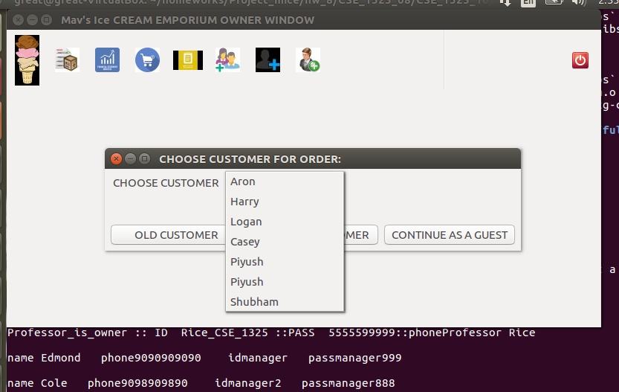
Creating an Order
To create an order you have to choose customer first and then start creating an actual order. If customer does not want to give his info then he / she can continue as a guest, and if he/she is old customer then you can choose from drop down menu.
While you can create new customer

Slide 8
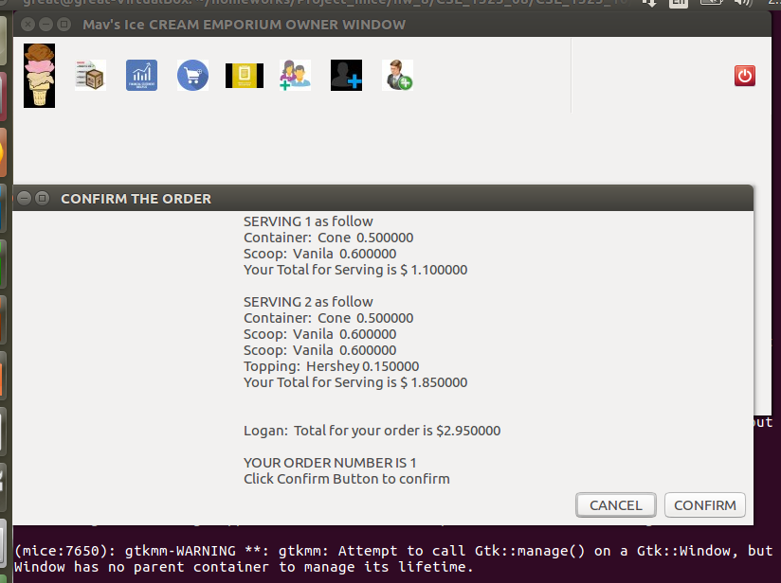
Creating order part 2
After creating or selecting an customer
Application will ask you to choose the container for serving, after choosing container you have to choose flavors for ice cream and then toppings for serving. After creating an serving application will ask for confirming the serving. You can create more than one serving in the order.
After confirming the whole servings for order in the end a dialog box will provide you the information for the total cost, serving and order number for your order.

Slide 9
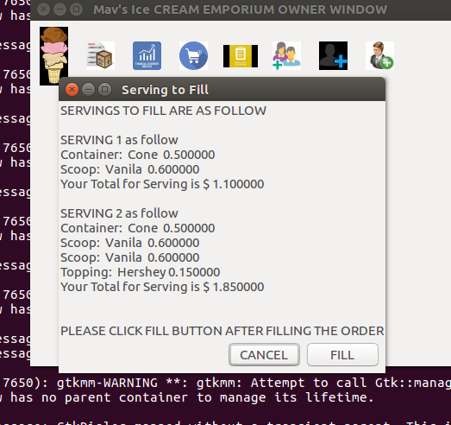
Filling the Order
After confirming the order the server will go for filling the order.
Over there server will choose an order which is not filled. After choosing an order, an dialog box will pop with the information for the order.

Slide 10
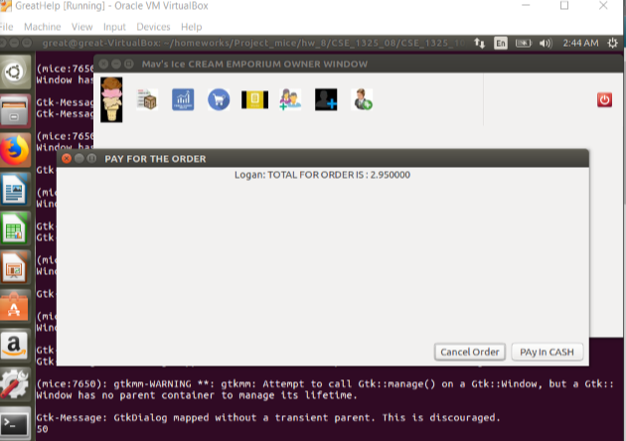
Order Payment
After filling the order you can go for the payment of the order.
The dialog will show you the total amount for the order you have to pay.
After payment you financial data (especially profit from order) will be stored in your profit file, for financial statement.

Slide 11
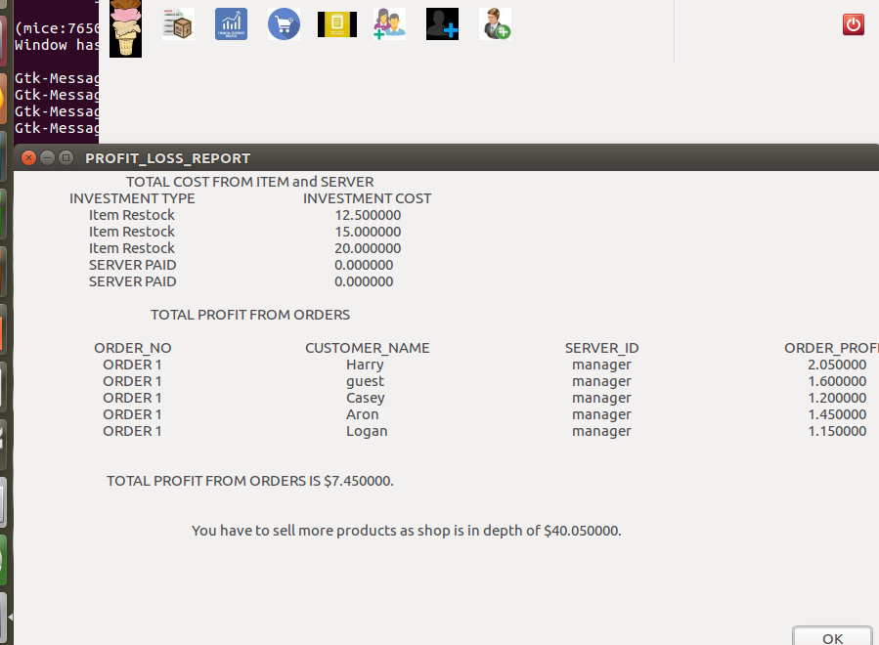
Financial Statement
When you will restock the item, your total cost will be stored in the data file for cost.
And your profit from orders will be stored in the different files so that cost and profit can not mixed up, when retrieving data.
When server get paid it also goes to the cost data file as a investment.

Slide 12

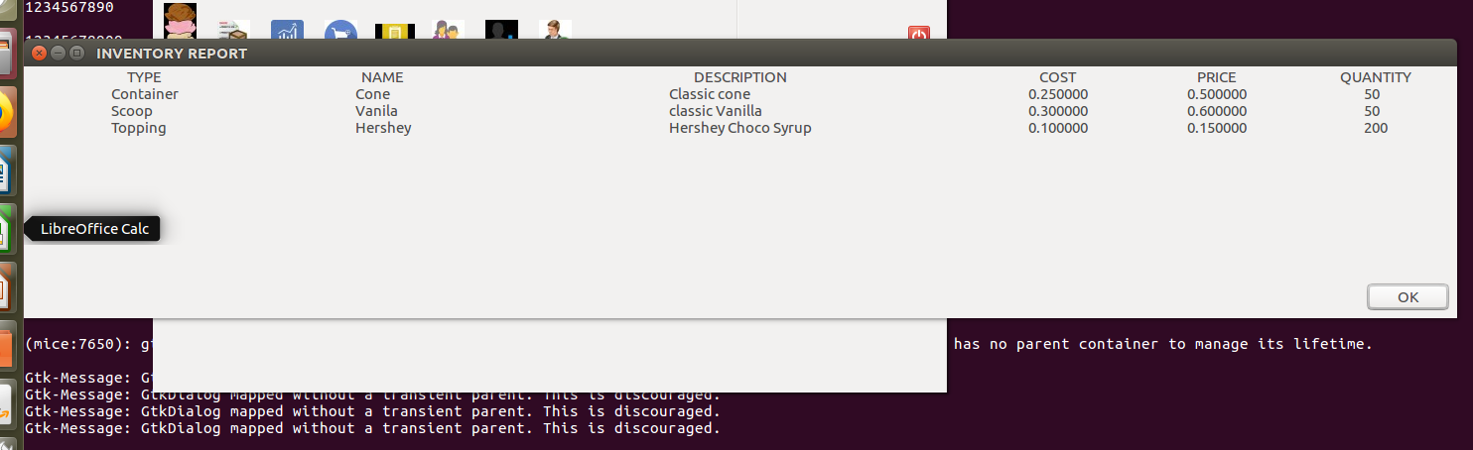



Inventory Report
You can easily access the data stored in your shop by inventory report.

Slide 13
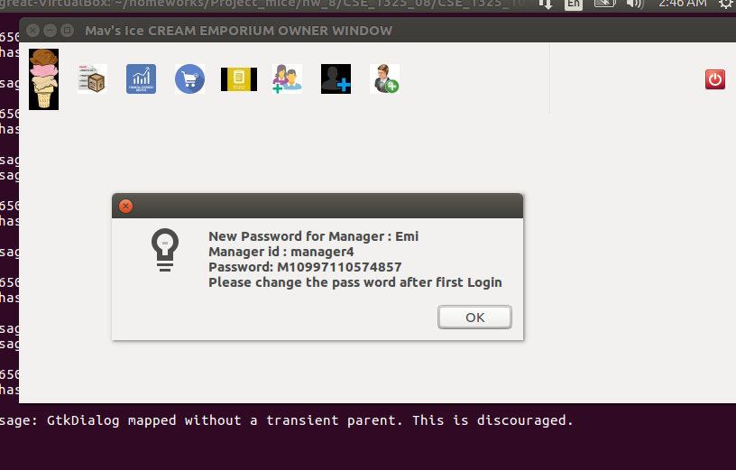
Creating Manager or Server
When you create your manager or server, application will ask for the name, phone and id for the person and after inputting the valid information for person. Application will provide a by default password for server or manager. Every by default is almost unique as the info for every person will be different.
This the by default message for the manager created by owner.

Slide 14
Conclusion
The application is under the process, you will see some great updates for the application, like you can create new emporium.
Many updates like reports based on the employee performance, and pre suggested ice cream combination for customer. So that customer will not be confused.
Changes can be made according to your requirement.

